Slide 1

Entity Framework Code-First
Syed Awn Ali

Slide 2
Entity Framework
Object/Relational Mapping (O/RM)
Enhancement to ADO.NET
Why Entity Framework?
Domain objects to relational database without much programming
Maintainable and extendable
Automates CRUD
Other ORMs
DataObjects.Net, NHibernate, OpenAccess, SubSonic

Slide 3
Types Of EF
Code First
Write your classes first
Model First
Create Entities, relationships, and inheritance hierarchies
Database First
Generate EDMX from existing database

Slide 4
Code First EF
Starts from Entity Framework 4.1
Features
Useful in Domain Driven Design
One-to-one, one-to-many and many-to-many relationship
DataAnnotation
Fluent API
Prerequisites:
.Net Framework3.5, C#, Visual Studio 2010 and MS SQL Server

Slide 5
Basic Workflow
Create classes
Create new database
Map your classes
Basic workflow:
Write code-first application classes
Hit F5 to run the application
Code First API creates new database or map with existing database from application classes
Inserts default/test data into the database
Finally launch the application

Slide 6
Simple Code First Example
Quick Start Example Demonstration

Slide 7
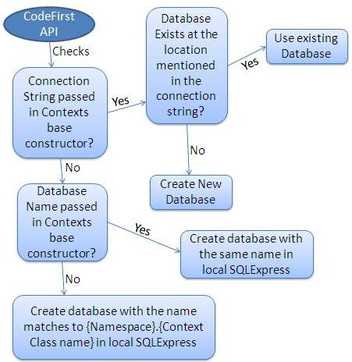
Database Initialization

Slide 8
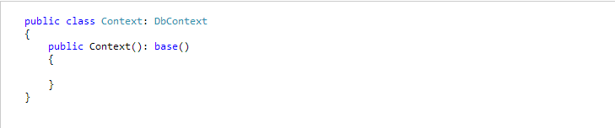
Database Initialization
No Parameter:
– Creates the database in your local SQLEXPRESS with name matches your {Namespace}.{Context class name}

Slide 9
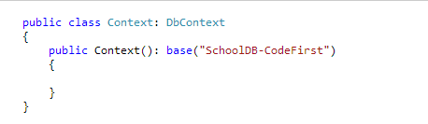
Database Initialization
Name:
– Creates database in the local SQLEXPRESS db server using that name

Slide 10
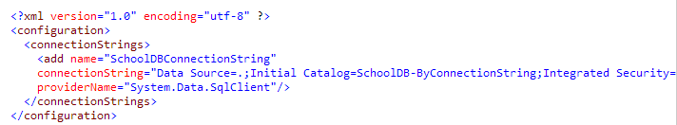
Database Initialization
ConnectionStringName:
– Create the database as per connection string

Slide 11
Database Initialization Strategies
CreateDatabaseIfNotExists:
Default initializer
Create the database if not exists
DropCreateDatabaseIfModelChanges:
Creates new database if your model classes have been changed
DropCreateDatabaseAlways:
Drops and Creates an existing database every time
Custom DB Initializer
Create your own custom initializer

Slide 12
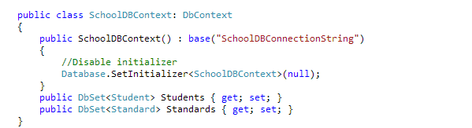
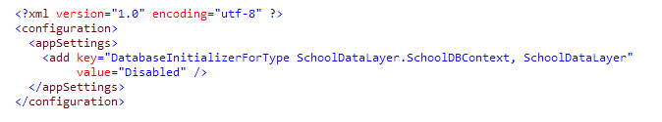
Turn off DB Initializer
Production environment you don’t want to lose existing data

Slide 13
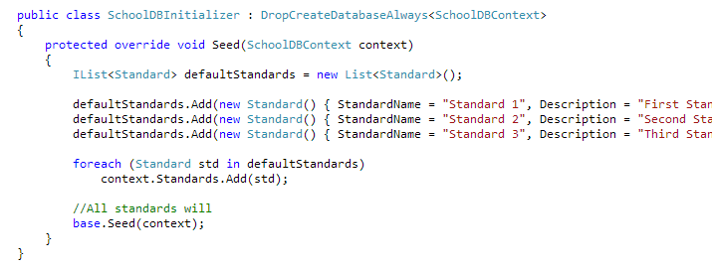
Seed Database
Provide some test data for your application

Slide 14
Configure Domain Classes
There are two ways by which you can configure your domain classes:
DataAnnotation
Fluent API

Slide 15
DataAnnotation
Attribute based configuration
System.ComponentModel.DataAnnotations namespace
Provides only subset of Fluent API
Don’t find some attributes in DataAnnotation then you have to use Fluent API

Slide 16
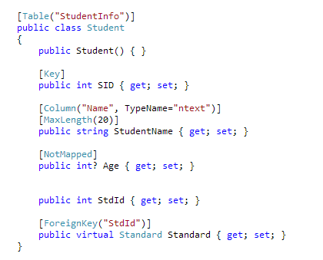
DataAnnotation
Example Code:

Slide 17
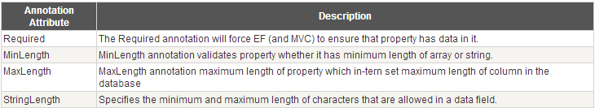
DataAnnotation
Validation Attributes:

Slide 18
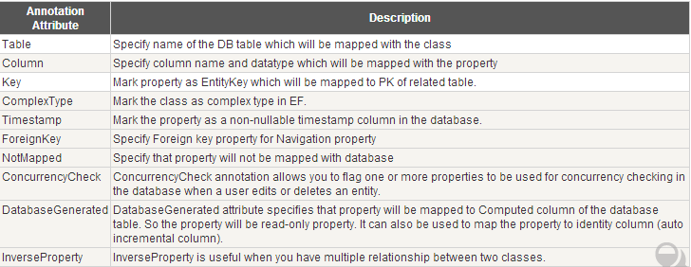
DataAnnotation
Database Schema related Attributes:

Slide 19
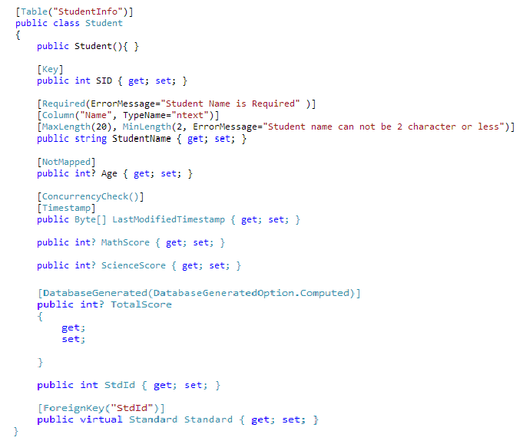
DataAnnotation

Slide 20
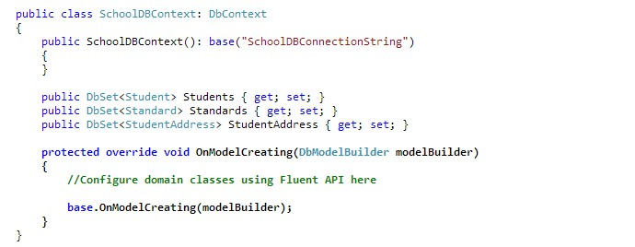
Fluent API
Don’t find some attributes in DataAnnotation then you have to use Fluent API
Example:

Slide 21
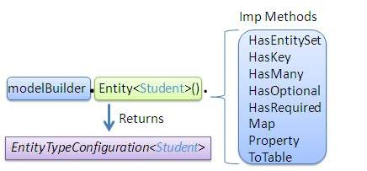
Fluent API
EntityTypeConfiguration Class:
Class that allows configuration to be performed for an entity type in a model
Obtained by calling Entity method of DbModelBuilder class

Slide 22
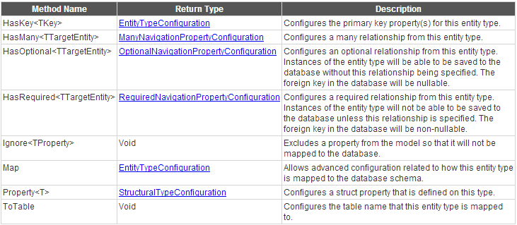
EntityTypeConfiguration Class
EntityTypeConfiguration has following important methods

Slide 23
Fluent API classes
Level 1:
DbModelBuilder Class
Main class
Level 2:
EntityTypeConfiguration
Set relationship between entities
Level 3:
ManyNavigarionConfiguration
OptionalNavigationPropertyConfiguration
RequiredNavigationPropertyConfiguration
Level 1 and Level 2 classes can be used to configure relationship between the entities that will be mapped to database tables
Level 3 & 4 can be used to configure additional mapping between the entities.

Slide 24
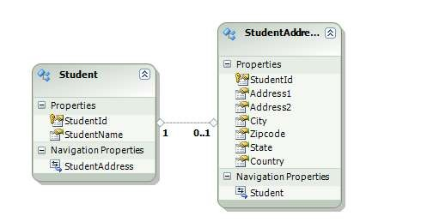
One-to-One Relationship
When primary key of one table becomes PK & FK in another table
Quick Start Example:

Slide 25
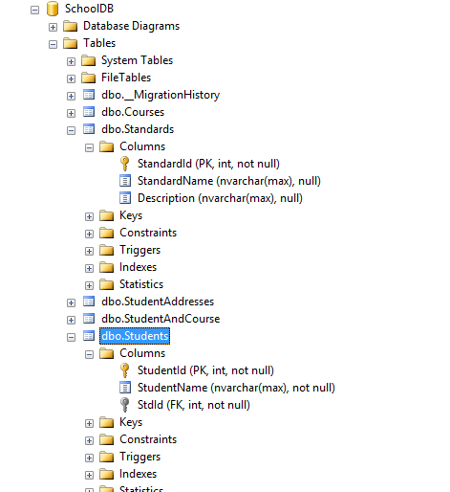
One-to-Many Relationship

Slide 26
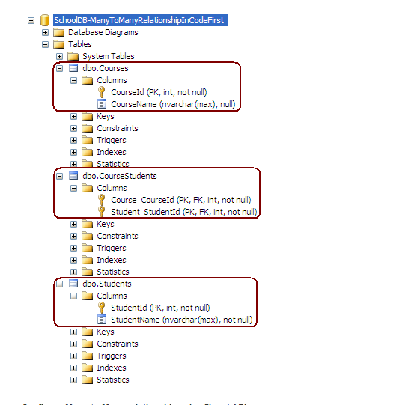
Many-to-Many Relationship

Slide 27
Migration in Code-First
Database initialization strategies:
CreateDatabaseIfNotExists
DropCreateDatabaseIfModelChanges
DropCreateDatabaseAlways
Problem:
Already have data
Existing Stored Procedures
Triggers
Kinds of Migration:
Automated Migration
Code based Migration

Slide 28
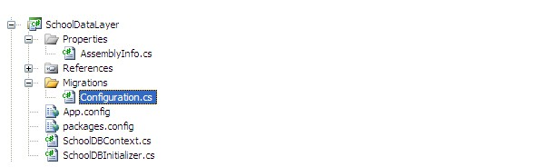
Automated Migration
Don’t have to maintain database migration manually in code file
Process:
Command: enable-migrations –EnableAutomaticMigration:$true
Need to set the database initializer
Run the application and see the created database
System table __MigrationHistory

Slide 29
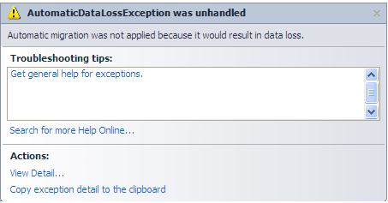
Automated Migration
Oops … If your Database tables already have data?
AutomaticMigrationDataLossAllowed = true
get-help enable-migrations

Slide 30
Code-based Migration
Commands:
Add-migration
Scaffold the next migration for the changes you have made
Update-database
Apply pending changes to the database
–verbose to see what’s going on in the database
Rollback Database change
Update-database -TargetMigration:"First School DB schema“
Get All Migrations
Use "get-migration" command to see what migration have been applied.

